Slide 1
DEALING WITH OBJECTS IN OOP
A Narrative Journey from "Spaghetti Code" to Modern Structures

Slide 2
DEALING WITH OBJECTS IN OOP
A Narrative Journey from "Spaghetti Code" to Modern Structures

Slide 3
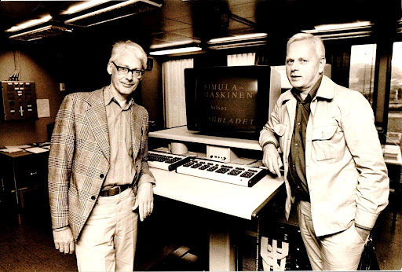
THE EVOLUTION OF SOFTWARE PROGRAMMING METHODS
1
1950s: SPAGHETTI CODE ERA
Before objects, programming was a linear chaos. Code jumped around unpredictably using GOTO statements. This "spaghetti code" was impossible to maintain. A small change in one place could break the entire system.

Slide 4
THE EVOLUTION OF SOFTWARE PROGRAMMING METHODS
1960s:
THE SOLUTION: SIMULA
2
Ole-Johan Dahl and Kristen Nygaard at the Norwegian Computing Center had a breakthrough. They invented Simula to simulate real-world systems (like exploding ships or queues). They introduced the concept of Classes and Objects to bundle data with behavior.

Slide 5
THE EVOLUTION OF SOFTWARE PROGRAMMING METHODS
3
1970s: Propagation and Purification
A team at Xerox PARC Laboratories, led by Alan Kay, developed the Smalltalk language. Smalltalk is considered the first purely object-oriented language. It established the concepts of encapsulation and polymorphism and introduced the term "object-oriented programming" itself.

Slide 6
THE EVOLUTION OF SOFTWARE PROGRAMMING METHODS
4
1980s: Widespread Adoption
The C++ language emerged (by Bjarne Stroustrup). C++ combined the power and speed of the procedural C language with OOP concepts. This combination made OOP available for use in developing complex systems and led to its widespread industrial adoption (e.g., operating systems, desktop applications).

Slide 7
THE EVOLUTION OF SOFTWARE PROGRAMMING METHODS
5
1990S & AFTER: OBJECTIFICATION MODEL DOMINANCE
Global Spread (Java, Python, C#): The emergence of languages ​​like Java and Python, whose core design is entirely based on OOP. OOP has become the dominant and standard model in modern software development, from web applications to large enterprise systems to smartphone apps.

Slide 8
THE CORE CONCEPTS OF OOP
CAR
BRAND: STR
MODEL: STR
MAX SPEED: INT
Think of a Class as a blueprint or a template. It defines the structure (Data/Properties) and capabilities (Methods/Functions) but doesn't exist as a tangible thing yet.
An Object is a specific instance created from the class blueprint. You can create thousands of objects from one class. Each has its own unique data (State) but shares the same structure.
CAR1
VOLVO
XC90
180 KM/H
CAR2
TESLA
MODEL Y
250 KM/H
CAR3
LEXUS
RX
210 KM/H
CAR4
FORD
RAPTOR
180 KM/H

Slide 9
PYTHON CODE:
CAR
BRAND: STR
MODEL: STR
MAX SPEED: INT
class Car:
def __init__(self, brand, model, max_speed):
self.brand = brand # STR
self.model = model # STR
self.max_speed = max_speed # INT
def display_info(self):
print(f"Brand: {self.brand}, Model: {self.model}, Max Speed: {self.max_speed} KM/H")
car1 = Car("VOLVO", "XC90", 180)
car2 = Car("TESLA", "MODEL Y", 250)
car3 = Car("LEXUS", "RX", 210)
car4 = Car("FORD", "RAPTOR", 180)
print("CAR1 Details:")
car1.display_info()
print("\nCAR2 Details:")
car2.display_info()
print("\nCAR3 Details:")
car3.display_info()
print("\nCAR4 Details:")
car4.display_info()
CAR1
VOLVO
XC90
180 KM/H
CAR2
TESLA
MODEL Y
250 KM/H
CAR5
MAZDA
3
190 KM/H
CAR3
LEXUS
RX
210 KM/H
CAR4
FORD
RAPTOR
180 KM/H
CAR6
AUDI
A4
240 KM/H
CAR7
SUBARU
OUTBACK
200 KM/H
CAR8
HYUNDAI
ELANTRA
185 KM/H
CAR9
PORSCHE
911
320 KM/H
CAR….
…
…
…

Slide 10
WHAT IF WE HAVE
1000 CARS?
CAR1
VOLVO
XC90
180 KM/H
CAR2
TESLA
MODEL Y
250 KM/H
CAR3
LEXUS
RX
210 KM/H
CAR4
FORD
RAPTOR
180 KM/H
CAR5
MAZDA
3
190 KM/H
CAR6
AUDI
A4
240 KM/H
CAR7
SUBARU
OUTBACK
200 KM/H
CAR8
HYUNDAI
ELANTRA
185 KM/H
CAR9
PORSCHE
911
320 KM/H
CAR….
…
…
…

Slide 11
WHAT IF WE HAVE
1000 CARS?
CAR1
VOLVO
XC90
180 KM/H
CAR2
TESLA
MODEL Y
250 KM/H
CAR3
LEXUS
RX
210 KM/H
CAR4
FORD
RAPTOR
180 KM/H
CAR5
MAZDA
3
190 KM/H
CAR6
AUDI
A4
240 KM/H
CAR7
SUBARU
OUTBACK
200 KM/H
CAR8
HYUNDAI
ELANTRA
185 KM/H
CAR9
PORSCHE
911
320 KM/H
CAR….
…
…
…
Creating objects like car1, car2... car1000 is inefficient. So, we use Object Arrays, Object Arrays allow us to store multiple objects in a single structured list, indexed by number. We can loop through the list to process all cars info at once

Slide 12
PYTHON CODE:
class Car:
def __init__(self, brand, model, max_speed):
self.brand = brand
self.model = model
self.max_speed = max_speed
def main():
cars_array = [
Car("VOLVO", "XC90", 180), # CAR 1
Car("TESLA", "MODEL Y", 250), # CAR 2
Car("LEXUS", "RX", 210), # CAR 3
Car("FORD", "RAPTOR", 180), # CAR 4
Car("MAZDA", "3", 190), # CAR 5
Car("AUDI", "A4", 240), # CAR 6
Car("SUBARU", "OUTBACK", 200), # CAR 7
Car("HYUNDAI", "ELANTRA", 185), # CAR 8
Car("PORSCHE", "911", 320) # CAR 9
]
for car in cars_array:
print(f"Brand: {car.brand}, Model: {car.model}, Speed: {car.max_speed} KM/H")
if __name__ == "__main__":
main()

Slide 13

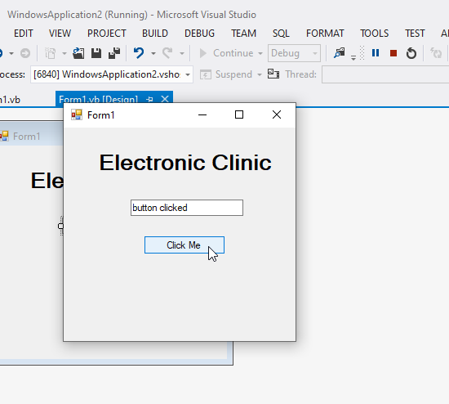
EVERYTHING IS AN OBJECT
In modern Windows apps, every button, text box, and window is an object.
You can create arrays of Buttons just like arrays of Cars to modify them programmatically(e.g., changing colors or text in a loop).

Slide 14
FROM CHAOS TO STRUCTURE
We journeyed from the "spaghetti code" of the 1950s to the organized, reusable Object-Oriented paradigms of today.
Whether in Python or VB.NET or any OOP language, Objects allow us to build complex, maintainable, and scalable software.

Slide 15
THANKS!
PREPARED BY:
AHMED SHEHATA SAID
AHMED TAMER ELSAYED
AYA MAGDY ABDULLAH
ESRAA SALAH MOHAMED
SARAH ESSAM ELDIN
UNDER SUPERVISION OF: DR. AMANI AL-JAMAL

